Slide 1
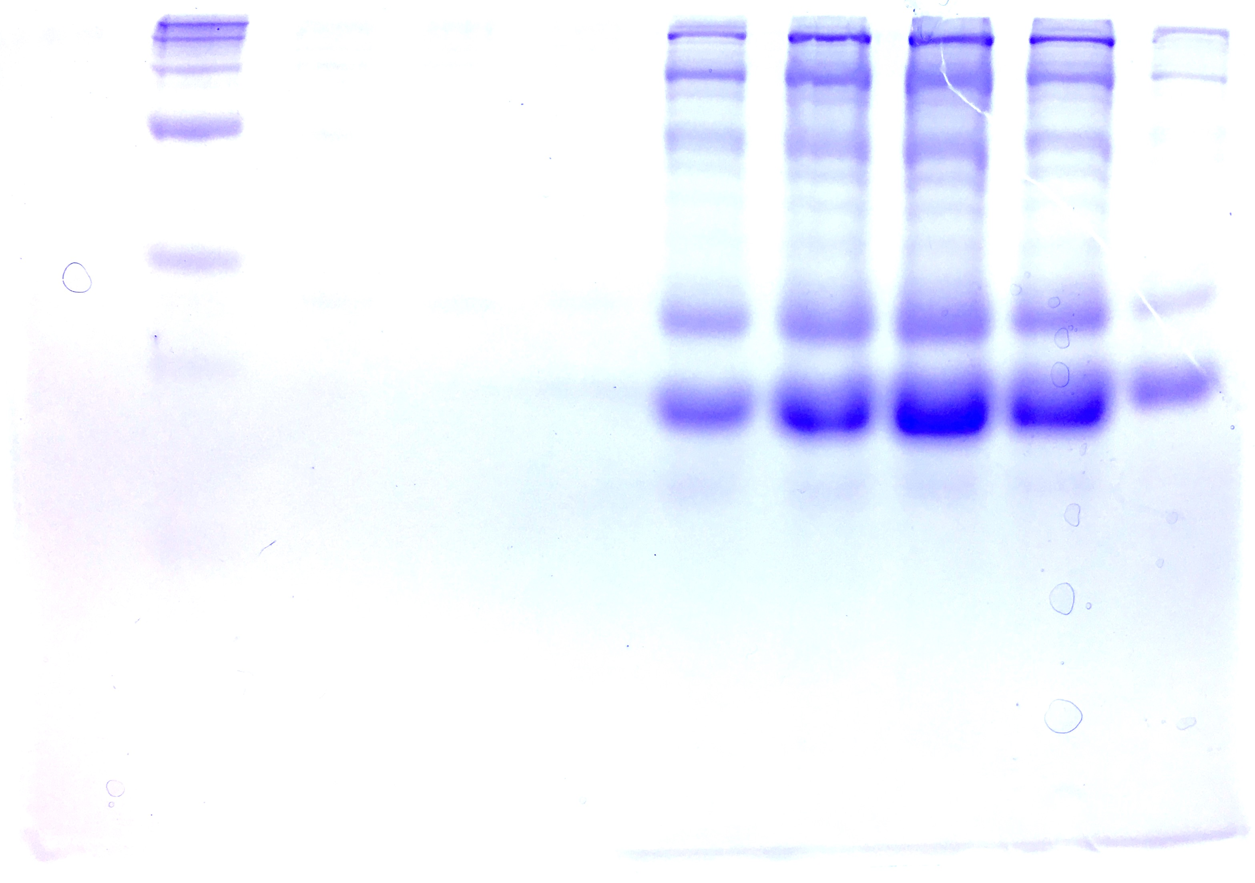
Polyacrylamide Gel Electrophoresis
By Angel Luis Vázquez Maldonado
November 8th, 2018

Slide 2
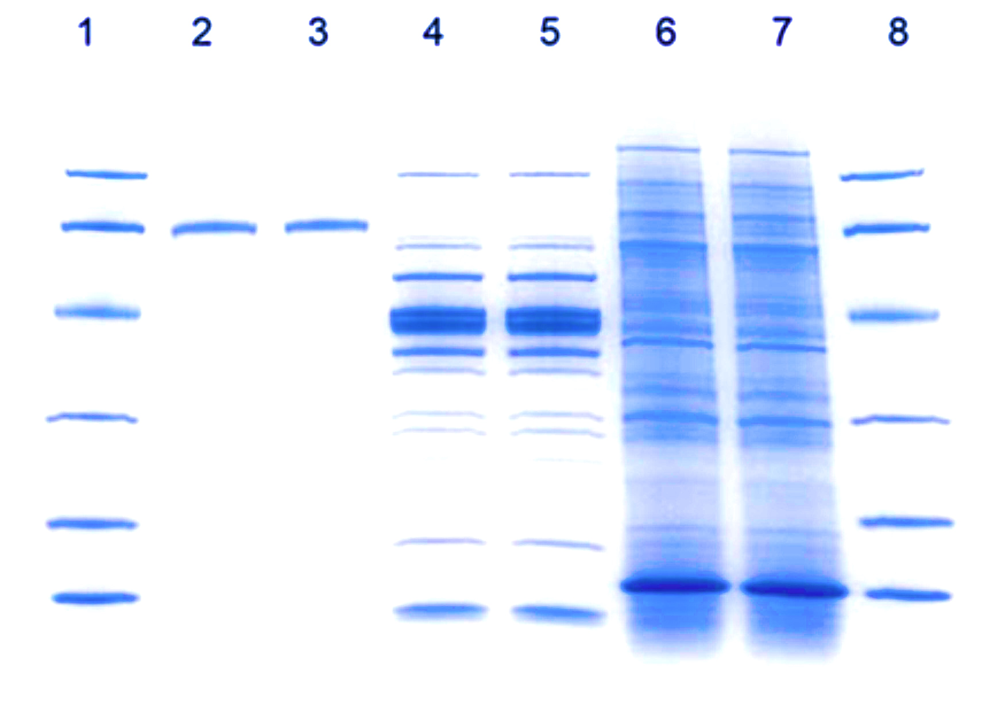


Gel Electrophoresis and its Purpose
Electrophoresis is derived from Greek
  Electro – refers to the electrical current that adds energy to the electrons of the molecule’s atoms
  phoresis – refers to the movement of the particles.
A technique used for separating macro molecules such as proteins, RNA and DNA.
  This is done using a gel matrix through which an electric current is applied.
Utilizes an electrical current to separate target molecules based on size, charge and other physical properties, through a porous gel matrix.
Oliver Smithies
Dephoff, J. The Purpose of Electrophoresis. https://sciencing.com/purpose-electrophoresis-5426937.html

Slide 3

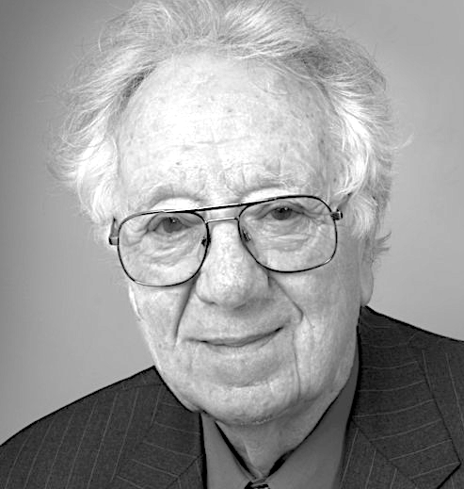
History of Gel Electrophoresis
Arne Tiselius is the pioneer of electrophoresis thanks to his successful protein separation experiment in 1937.
First gel electrophoresis technique was developed by Oliver Smithies in the 1950s
  Starch Gel Electrophoresis
Arne Tiselius
Oliver Smithies
Smithies, O.; Coffman, T. Annual Review of Physiology 2015, 77 (1), 1–11.
Notes:
U-shape experiment system (Tiselius aparatus) for separarating proteins in suspension by electrical charge.
Mother using starch powder for laundry and noticed that it turned into a jelly.
created a starch gel for insulin and noticed a band.
used his blood for analysis and then asked friends for their blood and identified differences in bands and extra bands on gels.
different hemoglobin types.

Slide 4
Fundamentals of Electrophoresis
Cathode (-)
Anode (+)

Slide 5
Types of Gel Electrophoresis
Depending on use and application, there are different medias that can be used for the electrophoresis.
  Paper – small molecules and amino acids
  Polyacrylamide gel – proteins and nucleic acids
  Agarose gel – very large proteins and nucleic acids
  Starch gel – proteins and nucleic acids
Gel electrophoresis can be divided by two categories.
  One dimension
    SDS-PAGE
    Native-PAGE
    Isoelectric Focusing (IEF)
  Two dimensions
    2D-PAGE
Flint, S.; Hartley, N.; Avery, S.; Hudson, J. Letters in Applied Microbiology 1996, 22 (1), 16–17.

Slide 6
Gel Composition
Media composition for SDS-PAGE and Native PAGE gels is acrylamide, which forms cross-linked polymers of polyacrylamide.
Gel is composed by two layers:
  Stacking Gel
  Separating Gel
Stacking promotes better resolution and sharper bands in separating gel.
Stacking Gel
Separating Gel
Thermofisher. Overview of Protein Electrophoresis. https://www.thermofisher.com/pr/en/home/life-science/protein-biology/overview-electrophoresis.html.

Slide 7
Polyacrylamide Polymer for Gels
Most commonly used for proteins.
Can offer small pore sizes.
Chemically inert.
Rapidly formed.
Acrylamide
N,N’-methylene
bisacrylamide
Sulfate
radicals
Persulfate ion
Thermofisher. Overview of Protein Electrophoresis. https://www.thermofisher.com/pr/en/home/life-science/protein-biology/overview-electrophoresis.html.

Slide 8
Sodium Dodecyl Sulphate Polyacrylamide Gel Electrophoresis (SDS-PAGE)
A method to separate proteins based strictly by their mass.
With the use of the strong protein-denaturing detergent SDS, the secondary and tertiary structures are disrupted by breaking hydrogen bonds and unfolding the protein.
Hegyi, G. Polyacrylamide gel electrophoresis. http://elte.prompt.hu/sites/default/files/tananyagok/IntroductionToPracticalBiochemistry/ch07s03.html.

Slide 9
Gel Preparation for SDS-PAGE
Assemble glass plates on casting frames and place on casting stand
  Make sure no leaking is happening through glass plates.
Prepare separating gel solution
Add solution to glass plates and allow to solidify. (~3-4 mL; must leave space for stacking gel)
  Add ~200 uL of Ethanol 35% on top so that the gel polymerizes smoothly.
Prepare stacking gel solution
Remove excess of ethanol on the glass plates and then add the stacking gel (~ 2 mL or until glass plate is almost full). Leave space for comb!
Insert well-forming comb without trapping air bubbles. Allow to gelate before using.
Bio-Rad. “A Guide to Polyacrylamide Gel Electrophoresis and Detection.” Bio-Rad Laboratories.

Slide 10
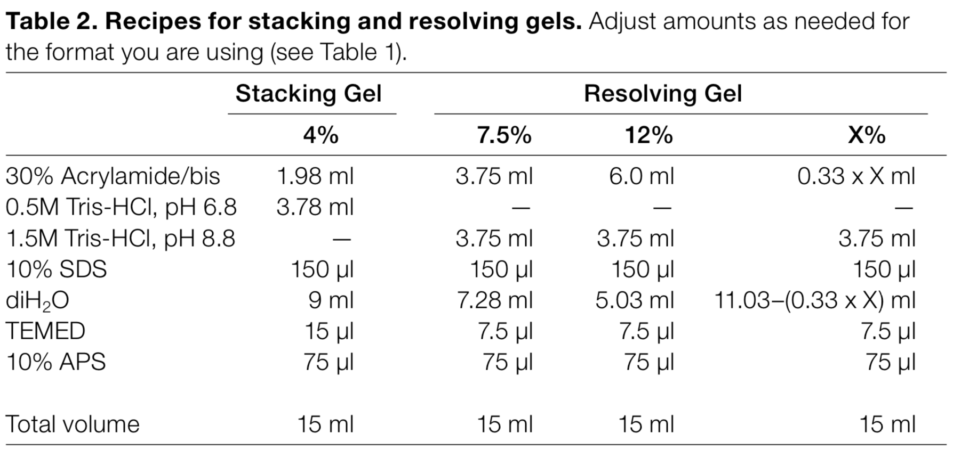
Separating and Stacking Recipes
*Separating=Resolving
**TEMED goes last
Bio-Rad. “A Guide to Polyacrylamide Gel Electrophoresis and Detection.” Bio-Rad Laboratories.

Slide 11
Sample Preparation and Loading
Prepare a sample staining solution.
  Add 10% of reducing agent 2-mercaptoethanol to staining solution (Coomassie Brilliant Blue)
Mix 2:1 Sample and staining solution.
Heat samples at 90 ºC for 1 minute.
Add samples to wells
  15-well gel – add 15 uL
  10-well gel – add 20 uL
Bio-Rad. “A Guide to Polyacrylamide Gel Electrophoresis and Detection.” Bio-Rad Laboratories.

Slide 12
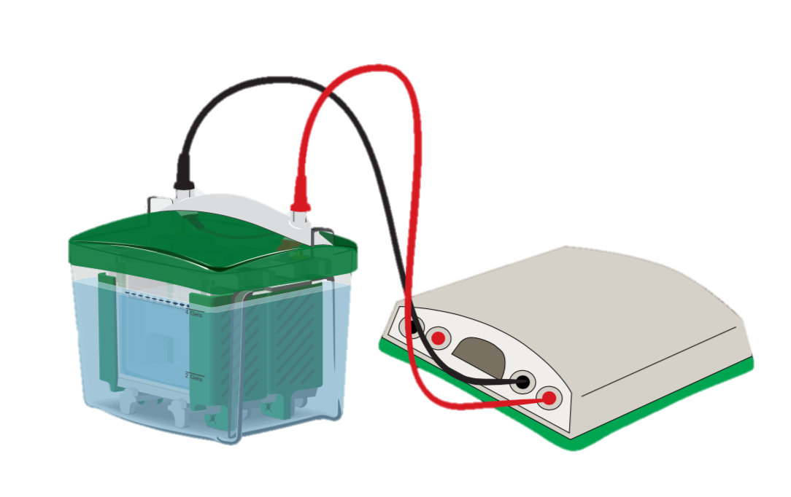
Sample Run and Staining/Destaining
After sample loading, gel is ready for run.
  Running conditions: 200 V
  Running time: ~40-50 min
Remove gel from glass plates and wash 3 times with distilled water.
Soak on Coomassie Brilliant Blue Stain and leave overnight gently agitating.
  0.1% Coomassie, 10% acetic acid, 40% methanol
Wash gel 3 times with distilled water.
Soak on destaining solution, add two kim wipes, microwave for 10 seconds and gently agitate for ~30–60 minutes
  10% acetic acid, 20% methanol
Analyze gel!
Bio-Rad. “A Guide to Polyacrylamide Gel Electrophoresis and Detection.” Bio-Rad Laboratories.

Slide 13
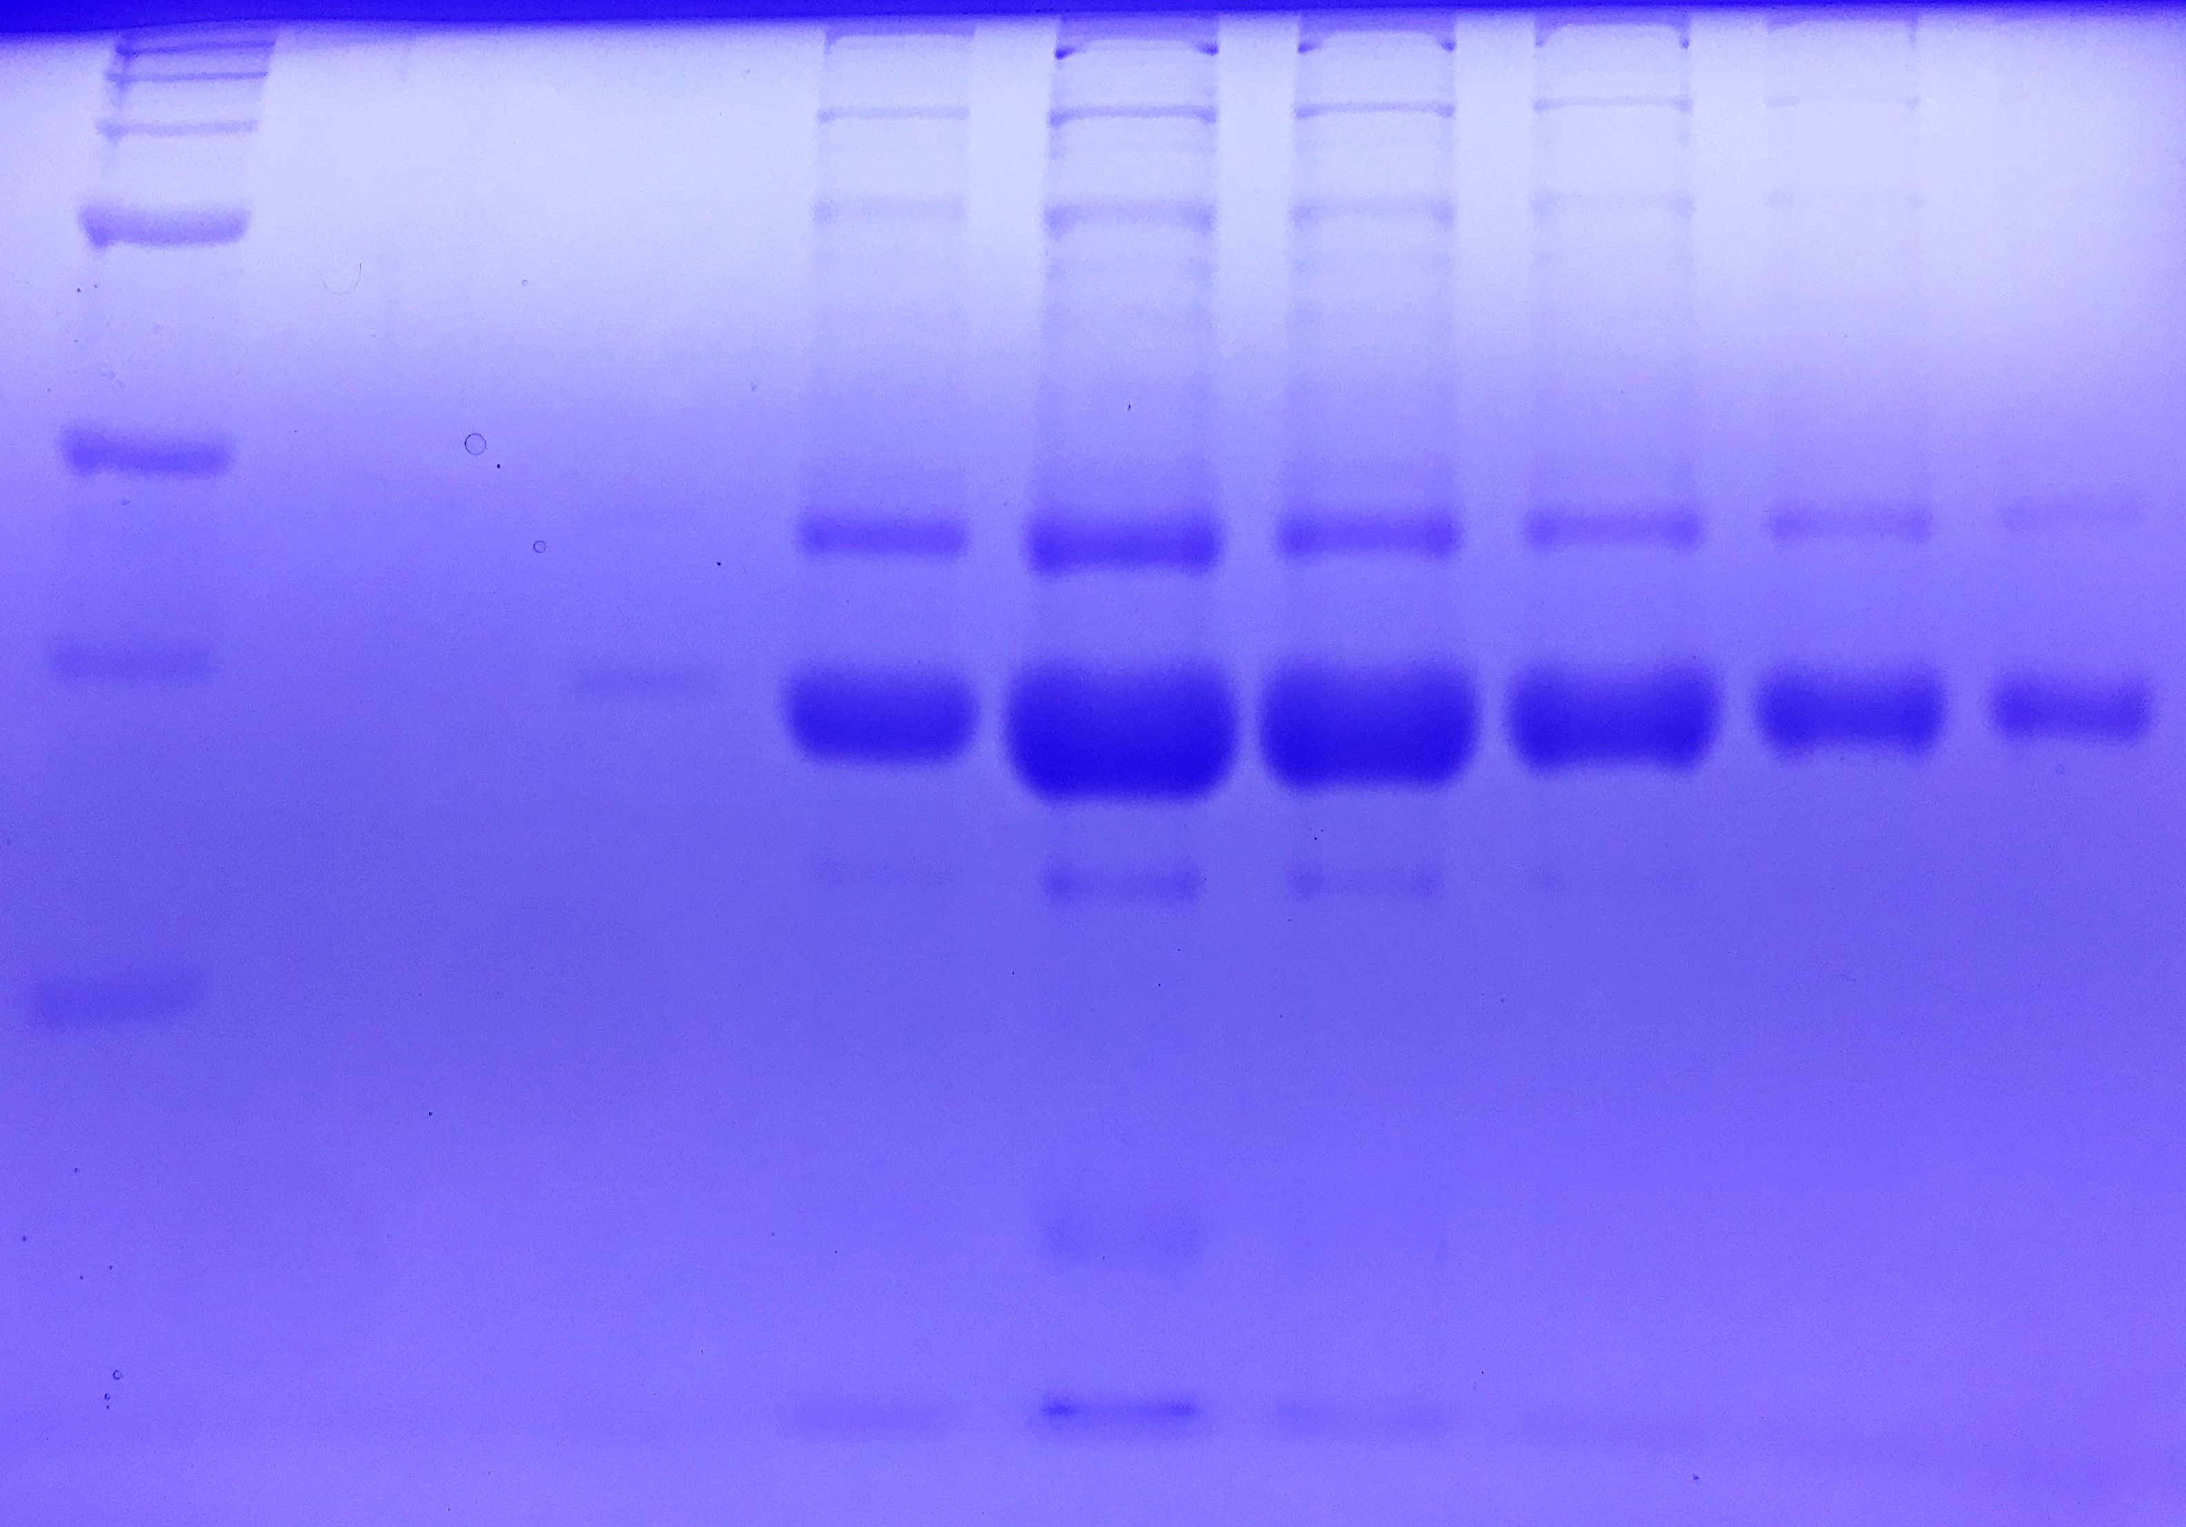
Destained SDS-PAGE Gel Example
Ladder
F1
F2
F3
F4
F5
F6
F7
F9
200 kDa
150 kDa 100 kDa
75 kDa
50 kDa
37 kDa
25 kDa

Slide 14
Native-Page
A method used to separate proteins in their native states according to difference in their charge density.
Native state means that proteins are in properly folded state, not denatured.
Mobility depends on protein’s charge and hydrodynamic size.
Proteins remains enzymatically active after separation.
  Can be used as a preparation procedure for protein purification.
Large, high (+) charge
Large, low (+) charge
Small, high (+) charge
Small, low (+) charge
Bio-Rad. “A Guide to Polyacrylamide Gel Electrophoresis and Detection.” Bio-Rad Laboratories.

Slide 15
Gel Preparation for Native-PAGE
Assemble glass plates on casting frames and place on casting stand
  Make sure no leaking is happening through glass plates.
Prepare separating gel solution
Add solution to glass plates and allow to solidify. (~3-4 mL; must leave space for stacking gel)
  Add ~200 uL of Ethanol 35% on top so that the gel polymerizes smoothly.
Prepare stacking gel solution
Remove excess of ethanol on the glass plates and then add the stacking gel (~ 2 mL or until glass plate is almost full). Leave space for comb!
Insert well-forming comb without trapping air bubbles. Allow to gelate before using.
Bio-Rad. “A Guide to Polyacrylamide Gel Electrophoresis and Detection.” Bio-Rad Laboratories.

Slide 16
Separating and Stacking Recipes
*Separating=Resolving
**TEMED goes last
Bio-Rad. “A Guide to Polyacrylamide Gel Electrophoresis and Detection.” Bio-Rad Laboratories.

Slide 17
Sample Preparation and Loading
Mix 2:1 Sample and sample buffer.
  Sample Buffer: 25% glycerol, 62.5 mM Tris-HCl, pH 6.8, 1% Coomassie Bright Blue
Add samples to wells
  15-well gel – add 15 uL
  10-well gel – add 20 uL
Bio-Rad. “A Guide to Polyacrylamide Gel Electrophoresis and Detection.” Bio-Rad Laboratories.

Slide 18
Sample Run and Staining/Destaining
To prevent protein denaturation by heat,
system should be placed on ice.
After sample loading, gel is ready for run.
  Running conditions: 100 V
  Running time: ~90-120 min
Remove gel from glass plates and wash 3 times with distilled water.
Soak on Coomassie Brilliant Blue Stain and leave overnight gently agitating.
  0.1% Coomassie, 10% acetic acid, 40% methanol
Wash gel 3 times with distilled water.
Destain on water with kim wipes.
Analyze gel!
Bio-Rad. “A Guide to Polyacrylamide Gel Electrophoresis and Detection.” Bio-Rad Laboratories.

